Slide 1
OPC UA
OPC Unified Architecture and Industry 4.0

Slide 2

Table of contents
What is an OPC UA?
Initial OPC project
Release of OPC UA
Where is used OPC UA?
Industry 4.0
OEE (Overall Equipment Effectiveness)
Smart manufacture
OPC UA protocols
OPC UA specifications
Traeger library C#
SDKs
Hirschman project demo
Komax Connect project demo

Slide 3
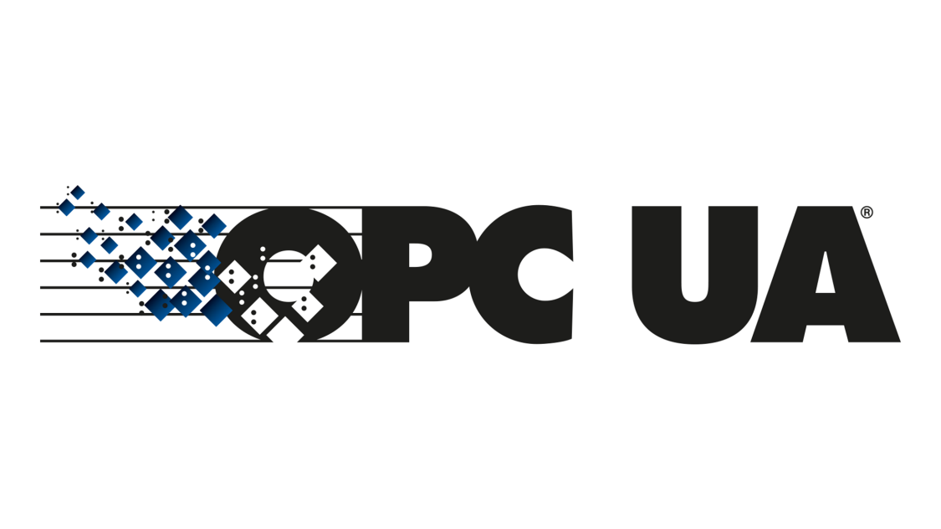
What is an OPC UA?
Open Platform Communications Unified Architecture
OPC UA is a data exchange standard for industrial communication (machine-to-machine or PC-to-machine communication).

Slide 4
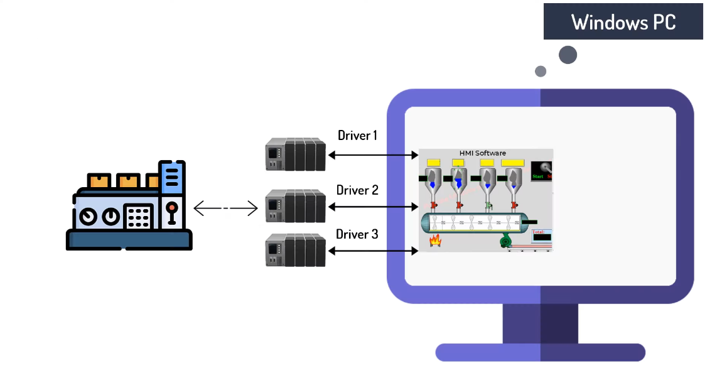
Before OPC
We have a driver diversity problems.
Our Windows OS system must have installed a bunch of drivers for the communication with all diversity of PLC devices.
Data is not easily passed to high level applications

Slide 5
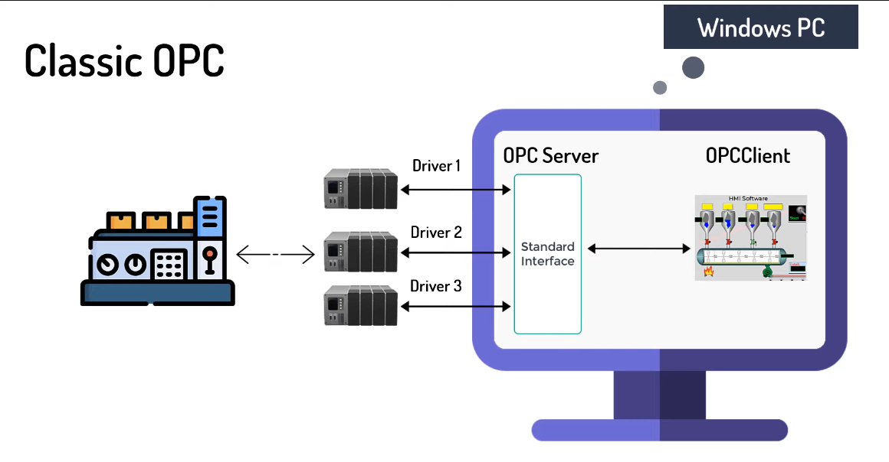
Classic OPC
Idea is to have a central standard interface (OPC Server) which can be accessed via OPC Clients.
On this way all PLC devices can upload there data on this OPC server and the same data can be accessed directly by OPC Clients.

Slide 6

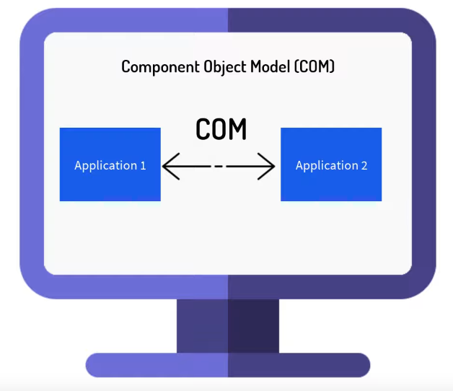
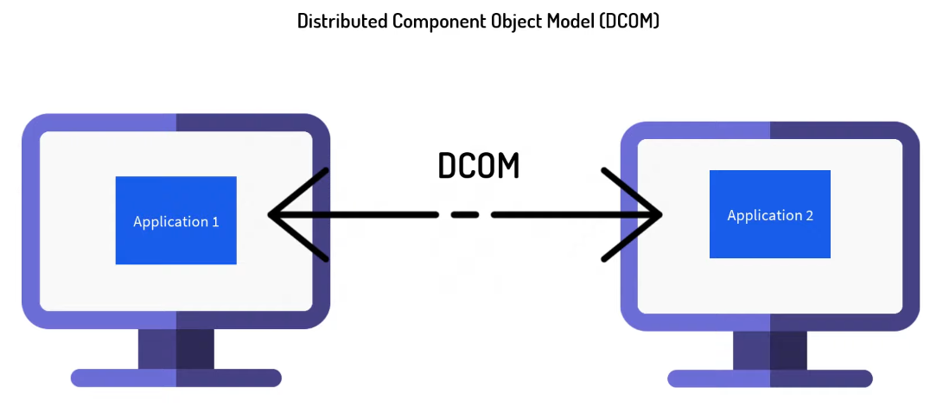
Initial OPC project
OPC UA is a successor of older OPC that was created in 1996 by OPC Foundation.
The communication is based on COM and DCOM which are Microsoft technologies.
It works only on Windows machines and has not so rich features like OPC UA.

Slide 7


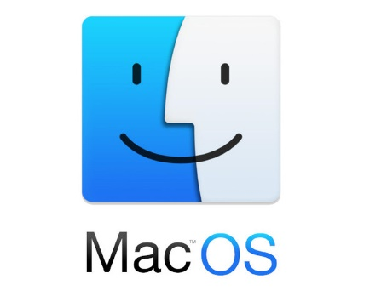


Release of OPC UA
Platform Independence
OPC UA first release is in 2008.
It has many more features than the old OPC.
It is platform independent and not only for Windows.
It has built in security and is Internet friendly oriented (No Firewall problems).
It is designed for work in Internet and specially for Industry 4.0.
It relies on TCP/IP protocol stack and uses Https and OPC binary protocol.
OPC UA
Firewall friend

Slide 8

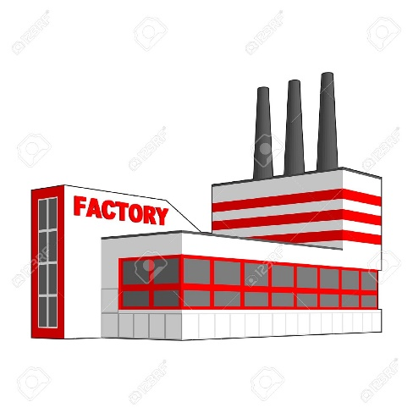


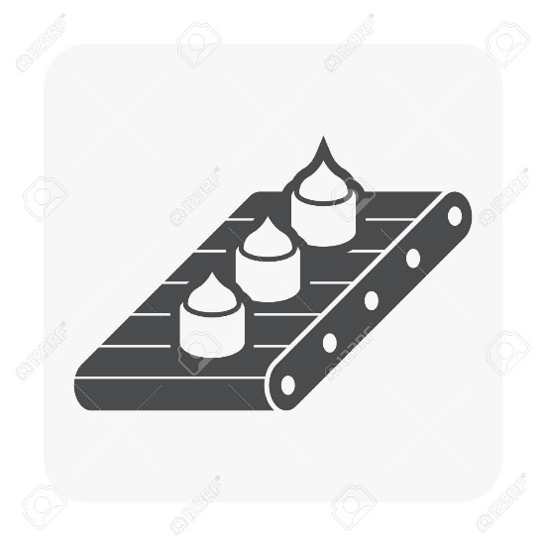
Where is used OPC UA?
OPC UA

Slide 9
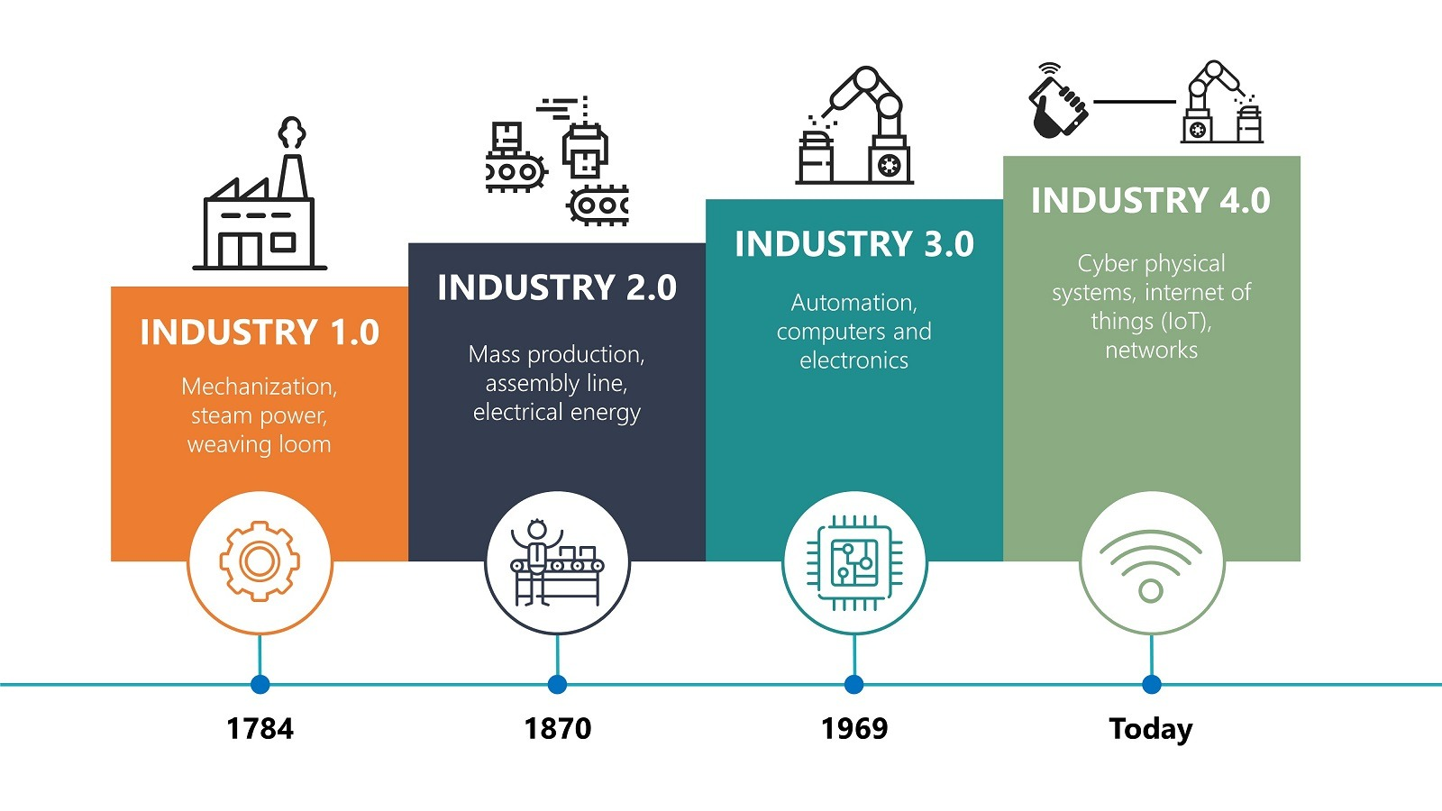
Industry 4.0
Industry 4.0 is the latest evolution of manufacturing.
It refers to the transformation of industry through the intelligent networking of machines and processes with the help of information and communication technology (ICT).
Different kinds of sensors gives the opportunity for making of smart factories where every machine action is traced.

Slide 10
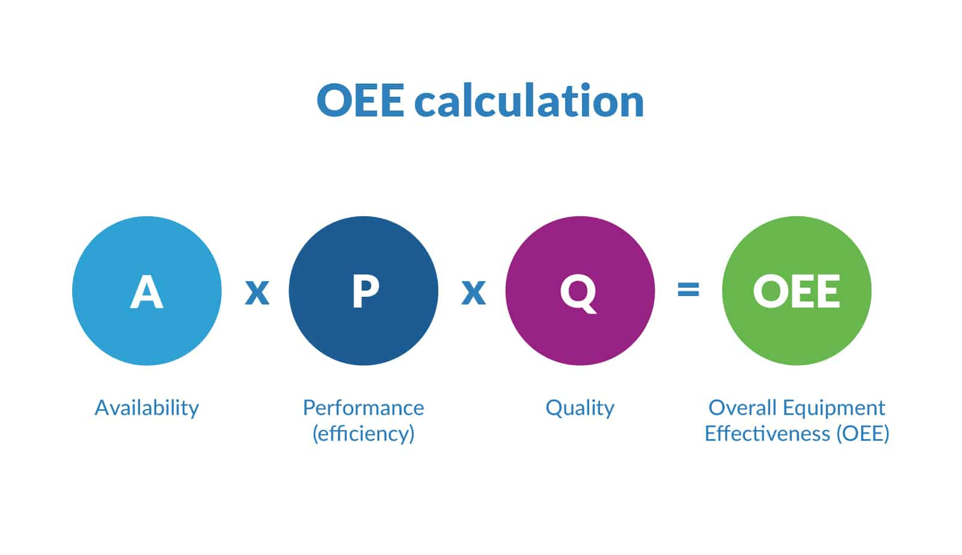
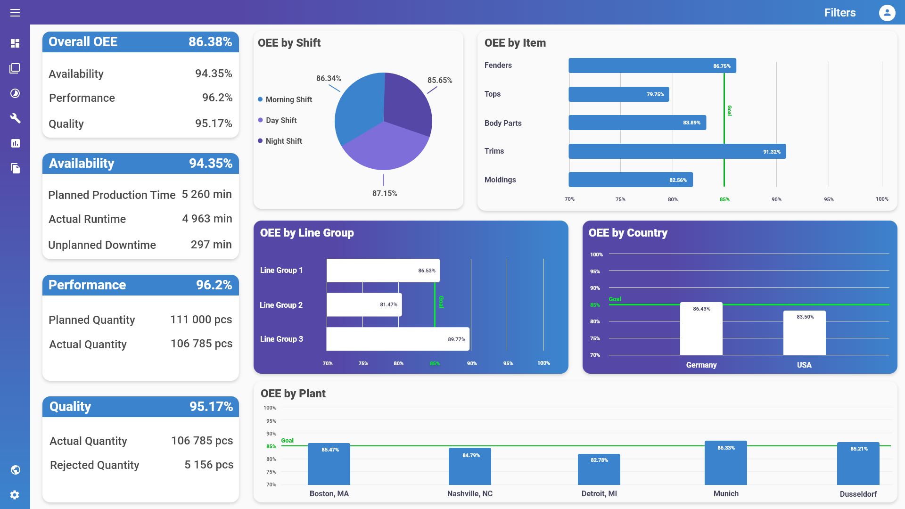
OEE (Overall Equipment Effectiveness)
It’s a gold standard for measuring manufacturing productivity.
By measuring of OEE and the underlying losses, we can get important insights on how to systematically improve our manufacturing process.

Slide 11
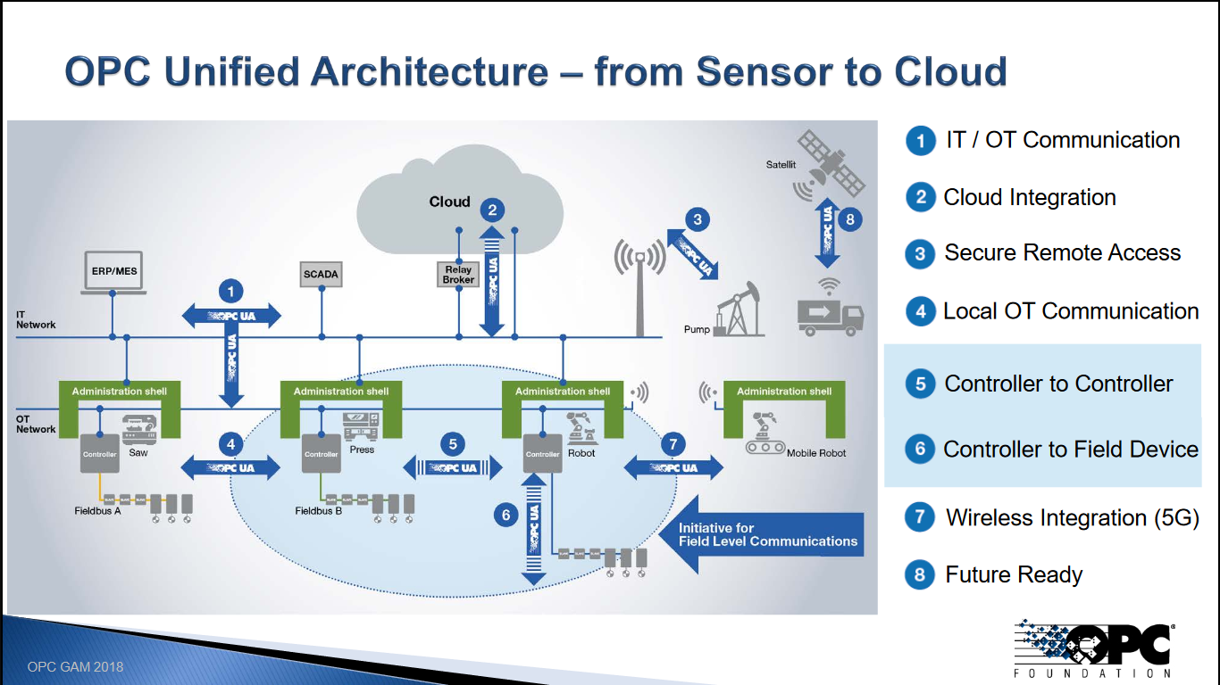
Smart manufacture

Slide 12
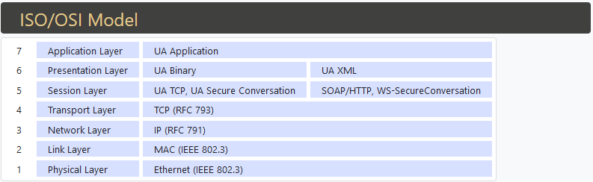
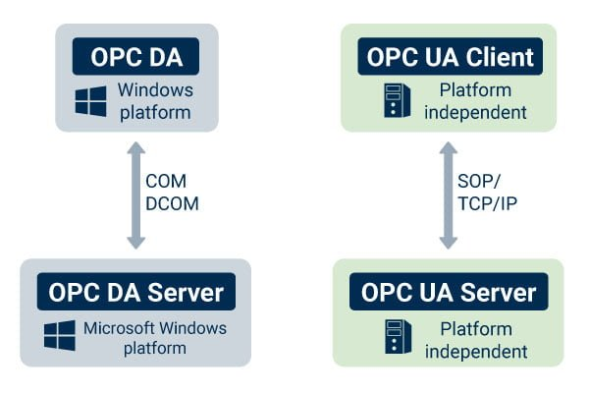
OPC UA protocols
OPC UA Binary
HTTPS with UA Binary encoded attachment
HTTPS/SOAP with XML encoded messages

Slide 13
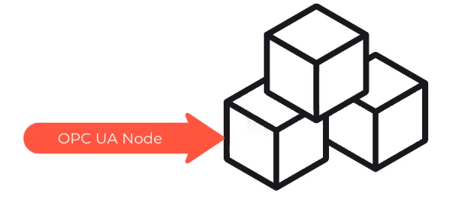

OPC UA Specifications
Information model
Communication architectures
Security
Historical access
Alarms and Events
Programs
"ns=2;s=/FloorOne/Machines/Pump"

Slide 14


Communication architectures
Pub/Sub model (notifications)
Client/Server model (session)
client
client
server
server
client
session
client
client

Slide 15
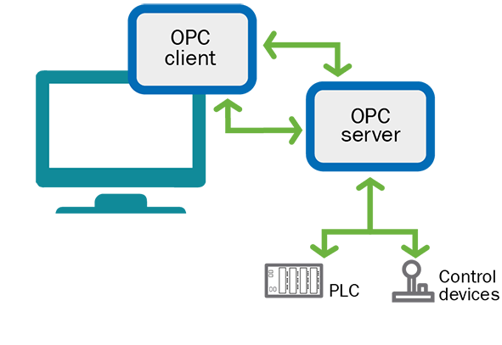
OPC UA simple workflow

Slide 16
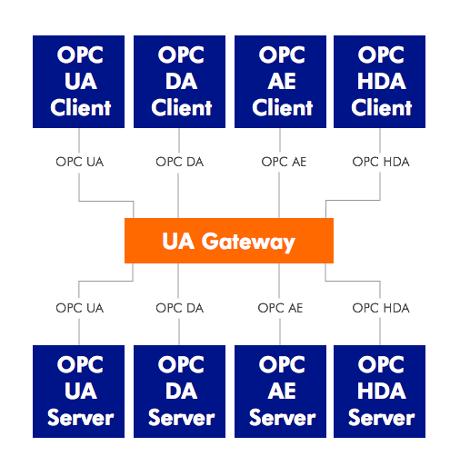
OPC Classic to OPC UA communication
OPC Classic and OPC UA devices/software cannot communicated directly.
The integration of the new OPC UA technologies in the existing manufactories is not so easy and have to be done step by step.

Slide 17
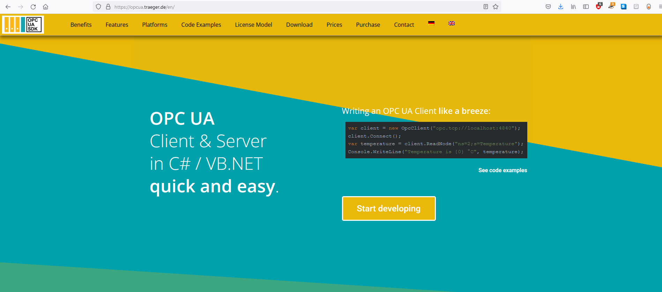
Traeger SDK (demo)
https://opcua.traeger.de/en/

Slide 18



SDKs
Helpful links:
https://www.unified-automation.com/products/server-sdk/c-ua-server-sdk.html
https://open62541.org/
https://industrial.softing.com/products/opc-ua-and-opc-classic-sdks.html

Slide 19
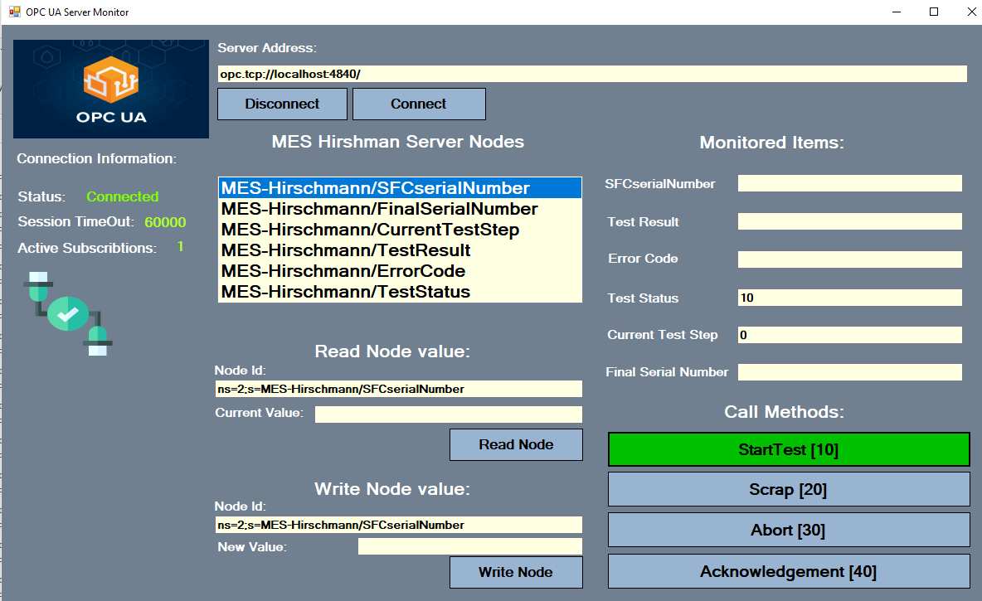

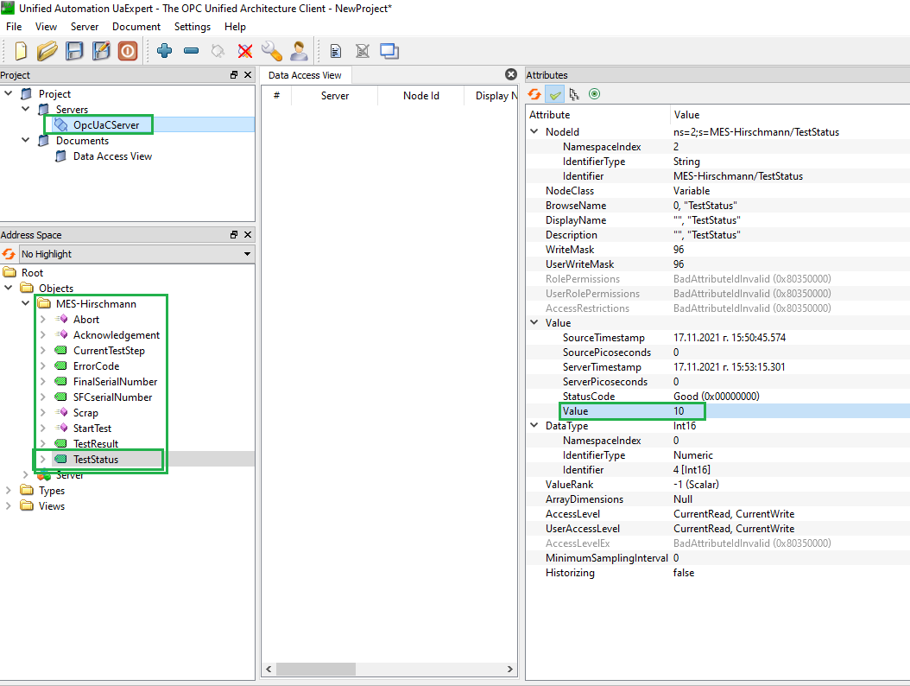
Hirschman project (demo)
client
read
server
write
read
publisher
client
write
subscriber

Slide 20
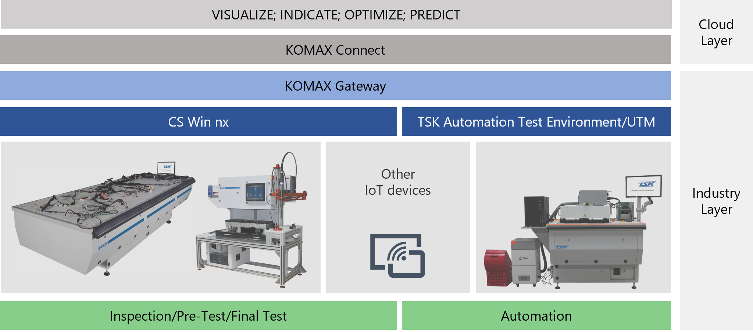
Komax Connect Project
We already have an initial connection between CS WIN and the cloud KOMAX system.
For this purpose were developed CS WIN COM object which serves as a OPC UA client and OPC UA server which is a Windows service app that running on the same PC.

Slide 21


KOMAX Connect Project (demo)
CS WIN
(OPC UA client
– COM object)
KOMAX Gateway
OPC UA server (Win service)
Cloud dashboard
write data
read data
OPC UA
OPC UA

Slide 22
Thank you
By: Velizar Gerasimov

